Slide 1
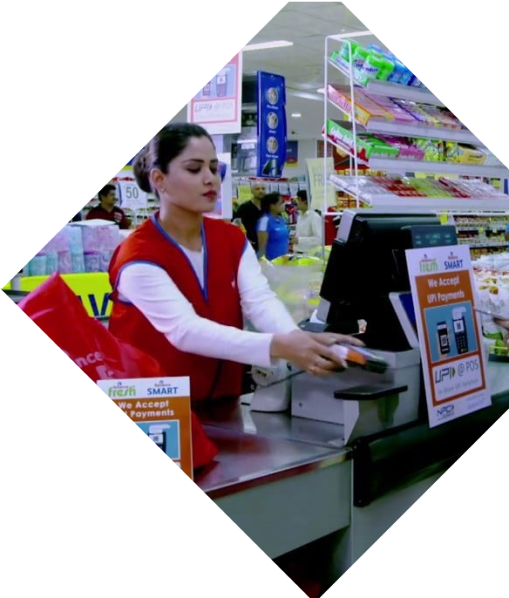

Department Store Product and Invoice Management
Submitted To :
Supervisor - Deepinder Kaur
Panelists - Shruti Sharma and Devinder Kaur
Submitted By :
Bharat (22BAI70174)
Mudit Singh (22BAI70171)
Neeraj Singh (22BAI70136)
Arun (22BAI70116)

Slide 2
CONTENTS :
1. | Abstract
2. | Introduction
3. | Literature Review
4. | Identification of Problem
5. | Benefits of Supermarket Billing System
6. | Key Features
7. | Case Study & Future Scope
8. | Conclusion & References

Slide 3

Abstract
Department store product and invoice management are critical aspects of retail operations. Efficient management of inventory and invoices can help retailers minimize stock-outs, reduce waste, and maintain accurate financial records. This paper discusses the importance of effective department store product and invoice management, the challenges associated with these processes, and the technology solutions available to retailers

Slide 4


INTRODUCTION
In a Department Store , product management includes tasks such as managing inventory levels, ensuring products are adequately stocked, and tracking sales trends. Effective product management involves a combination of technology, data analysis, and inventory management strategies to ensure that the store always has the right products in stock and is meeting the needs of its customers.

Slide 5

Literature Review
Department Store management encompasses inventory management, product assortment, and shelf space optimization. Efficient management of these areas ensures adequate stock levels, optimal product variety, and improved store performance. Supermarket invoice management involves invoice processing, supplier relationship management, and cost management. Automating invoice processing, fostering strong supplier relationships, and analyzing costs contribute to streamlined financial processes and enhanced profitability

Slide 6


IDENTIFICATION OF PROBLEM
The old manual system was suffering from a series of drawbacks. Since the whole of the system was to be maintained with hands the process of keeping, maintaining and retrieving the information was very tedious and lengthy. The records were never used to be in a systematic order. There used to be lots of difﬁculties in associating any particular transaction with a particular context. If any information was to be found it was required to go through the different registers, documents there would never exist anything.

Slide 7
Manual Billing vs Automated Billing
Manual billing systems are time- consuming and prone to errors. Automated billing systems reduce errors and save time. It enables real- time inventory management and assists in tracking sales data for better decision-making. Automated billing systems also help in streamlining the checkout process, reducing wait times for customers.

Slide 8
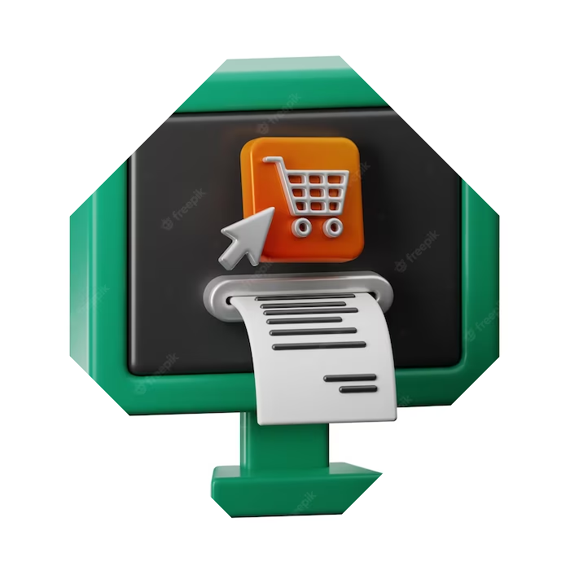
Features of a Department Store System
A good Department Store billing system should have features like real-time inventory management, sales tracking, and reporting. It should integrate with other systems, like accounting software, to provide a holistic view of the business. It should also be easy to use and provide training and support to staff.

Slide 9
KEY FEATURES OF DEPARTMENT STORE PRODUCT AND INVOICE MANAGEMENT
Invoice generation: The invoice generation feature of the Department Product Store and Invoice Management project aims to provide a user-friendly and efficient system for generating invoices and managing customer accounts.

Slide 10
KEY FEATURES OF DEPARTMENT STORE PRODUCT AND INVOICE MANAGEMENT
Inventory management: The inventory management feature of the Department Product Store and Invoice Management project aims to provide an efficient and accurate system for managing inventory levels and tracking product availability.

Slide 11
KEY FEATURES OF DEPARTMENT STORE PRODUCT AND INVOICE MANAGEMENT
Sales data analysis: The sales data analysis feature of the Department Product Store and Invoice Management project aims to provide insights into sales trends and customer behavior, which can be used to inform marketing and sales strategies.

Slide 12
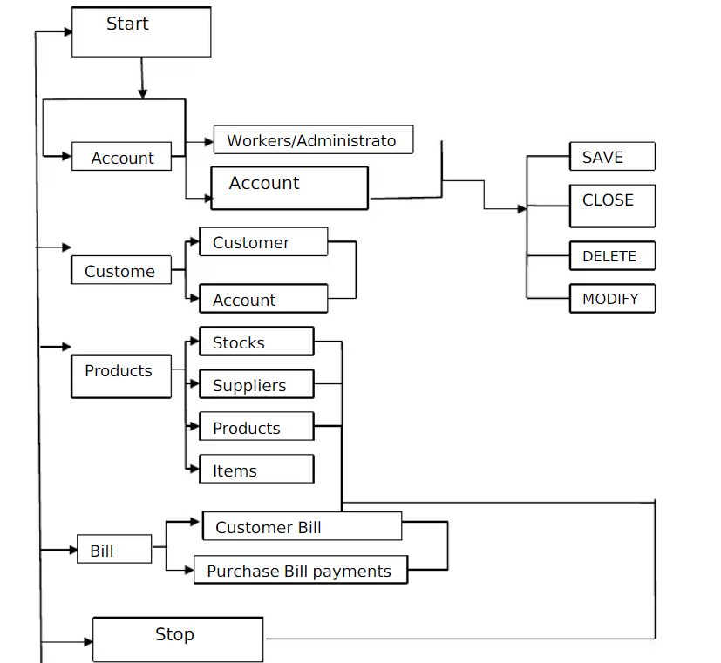
Flow Diagram

Slide 13
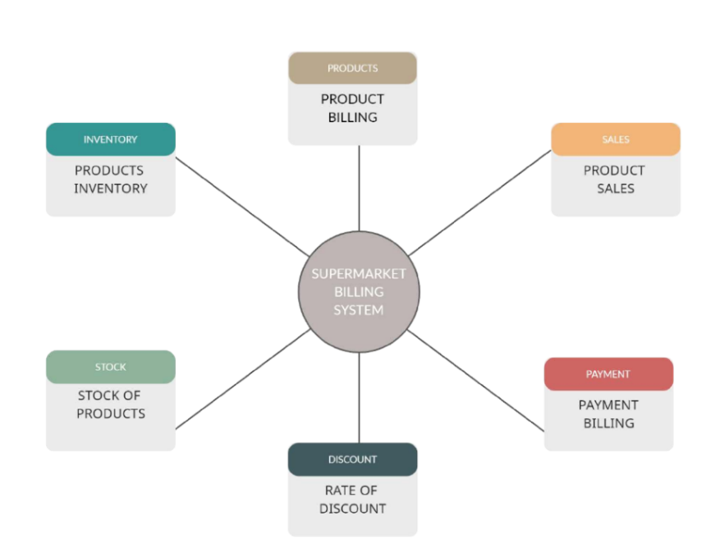
Flow Diagram

Slide 14
Benefits of a Department Store Billing System
A Department Store billing system can help reduce errors, save time, and improve customer satisfaction. It helps in tracking sales data for better decision-making, reducing inventory wastage, and managing supplier relationships. It also helps in compliance with regulations and reduces the risk of fraud.

Slide 15

Case Study: Supermarket X
Supermarket X implemented an efﬁcient billing system that reduced wait times for customers by 50%.
Real-time inventory management
helped in reducing inventory wastage by 20%. Sales data analysis helped in identifying popular products and creating targeted marketing campaigns. The system also helped in managing supplier relationships and reducing errors.

Slide 16
Conclusion
In conclusion, a department store billing system is an essential tool for streamlining retail operations. It reduces errors, saves time, and improves customer satisfaction. By implementing an efﬁcient billing system, supermarkets can improve their operations, reduce costs, and increase proﬁts.

Slide 17
Future Scope
The future scope of Department store product and invoice management is very promising. With the ever-increasing demand for Management and the need for more efficient and effective methods of data collection, the development of store is crucial. This software has the potential to revolutionize the way we study and understand the management. As technology advances, the capabilities of Managing continue to grow. This Software will become more nimble and able to maneuver.

Slide 18
References
1. Durbach, I. N., Elia, V., & Wagner, M. (2017). Forecasting retail product sales and supermarket product demand: A review. European Journal of Operational Research, 259(2), 689-701.
2. Selvaraj, R., Sushmitha, S., Kishore, V., & Shivakumar, S. (2019). An empirical study on the relationship between inventory management practices and organizational performance in retail supermarkets. Journal of Retailing and Consumer Services, 46, 54-62.
3. Elbashir, M. Z., Collier, P. A., & Davern, M. J. (2017). What is the value of assortments to supermarkets? An empirical investigation of the impacts of SKU assortment characteristics on retail performance. Journal of Retailing and Consumer Services, 35, 118-129.
4. Chen, C. L., Lin, T. M. Y., & Tsai, Y. H. (2019). Optimal product assortment for a supermarket under spatial competition. International Journal of Production Economics, 212, 101-111.

Slide 19
Thank You

